Slide 1


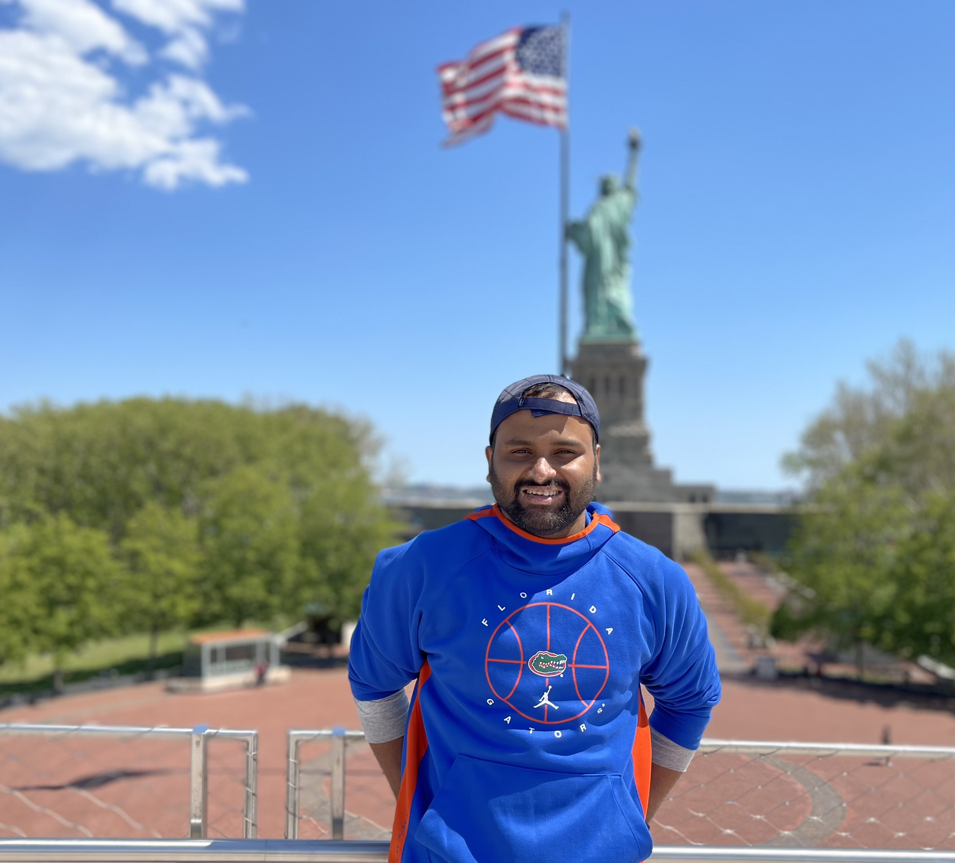
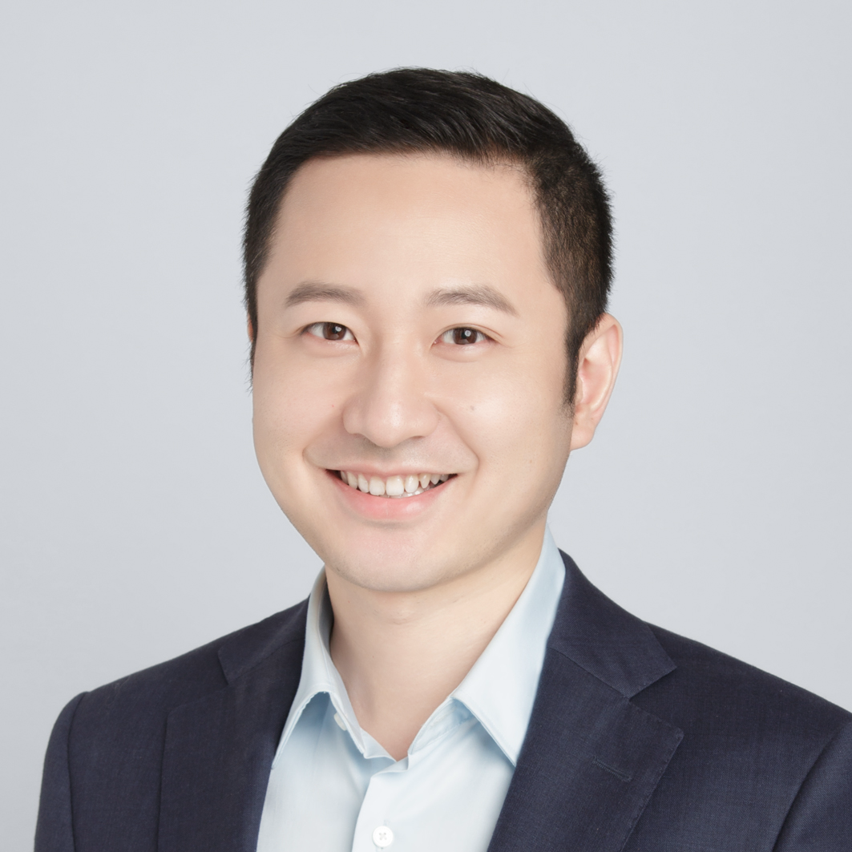
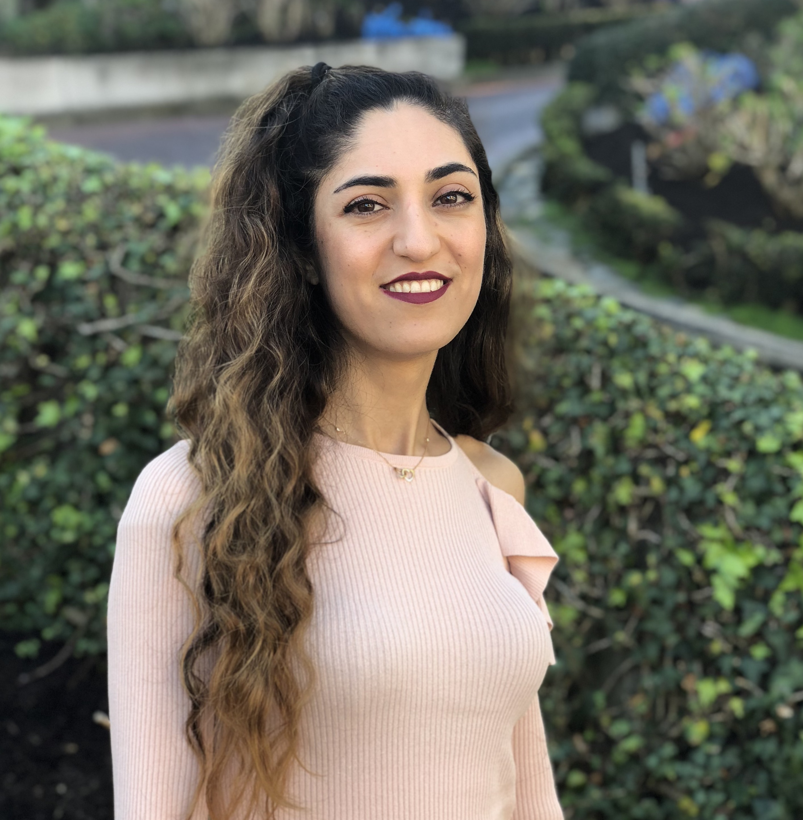
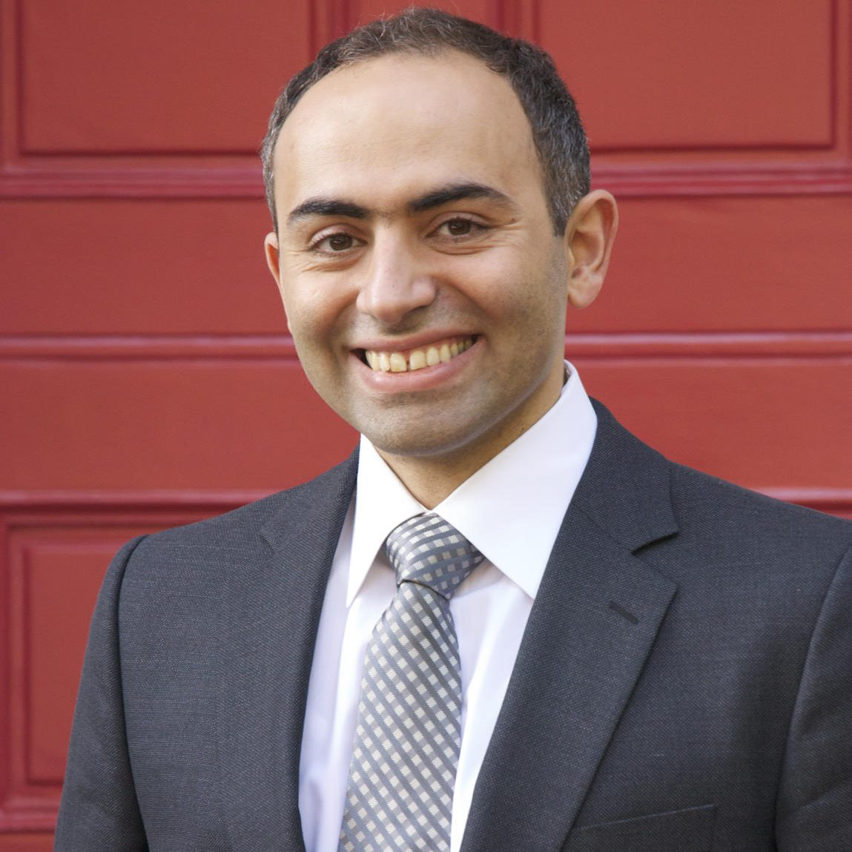


Dividing and Conquering a BlackBox to a Mixture of Interpretable Models: Route, Interpret, Repeat
Shantanu Ghosh¹, Ke Yu², Forough Arabshahi³, Kayhan Batmanghelich¹
¹BU, ²Pitt ISP, ³Meta

Slide 2
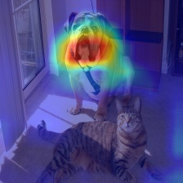
DL model explanation is dichotomous
Create
a
Blackbox
2
1
Explain post-hoc
Saliency Maps. Simonyan et al. arXiv 2014.
CAM. Zhou et al. CVPR 2016.
GRAD-CAM. Selvaraju et al. ICCV 2017.
SmoothGrad. Smilkov et al. ICML 2017 and more..

Slide 3
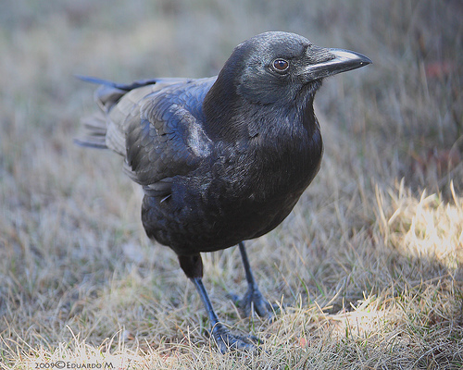
DL model explanation is dichotomous
Concepts
CNN
bill_length_shorter_than_head
Classifier
bill_shape_allpurpose
Common Raven
wing_shape_roundedwings
…
Concept Bottleneck Model. Koh et al. ICML 2020
Concept Embedding Models. Zarlenga et al. Neurips 2022
Ante-hoc Explainable Model. Sarkar et al. CVPR 2022
E-LENs Barbiero et al. AAAI 2022 and more..

Slide 4
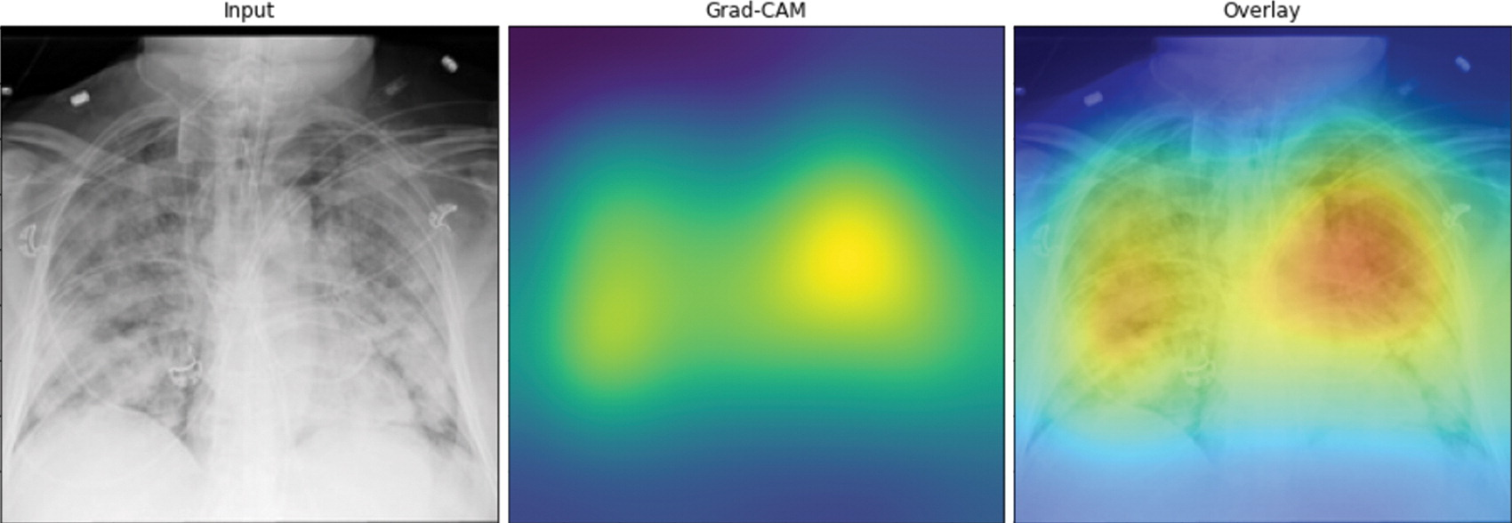
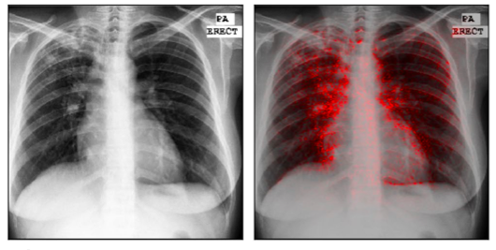
Post-hoc explanations fails on CXRs
Poor localization
Affinity for edges
Picture credit: DeepCOVID-XR: An Artificial Intelligence Algorithm to Detect COVID-19
on Chest Radiographs Trained and Tested on a Large U.S. Clinical Data Set
Picture credit: Identifying pneumonia in chest X-rays: A deep learning approach

Slide 5
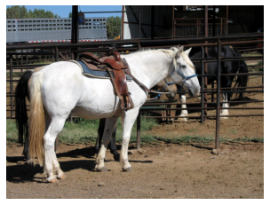
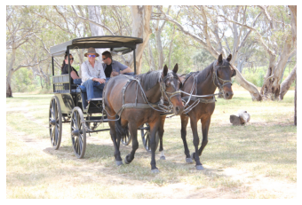
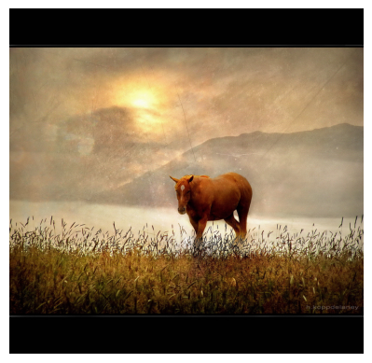
CBM explanations are generic

Slide 6
CBM offers inferior performance
Generic explanations
Poor performance on real life datasets (MIMIC-CXR)
0.92
0.91
0.78
0.84
AUROC
0.75
0.72
CBM (Sequential)
Blackbox
Effusion
Pneumothorax
Cardiomegaly

Slide 7
We extract a mixture of concept based
interpretable models from a Blackbox

Slide 8
Route, interpret and repeat

Slide 9
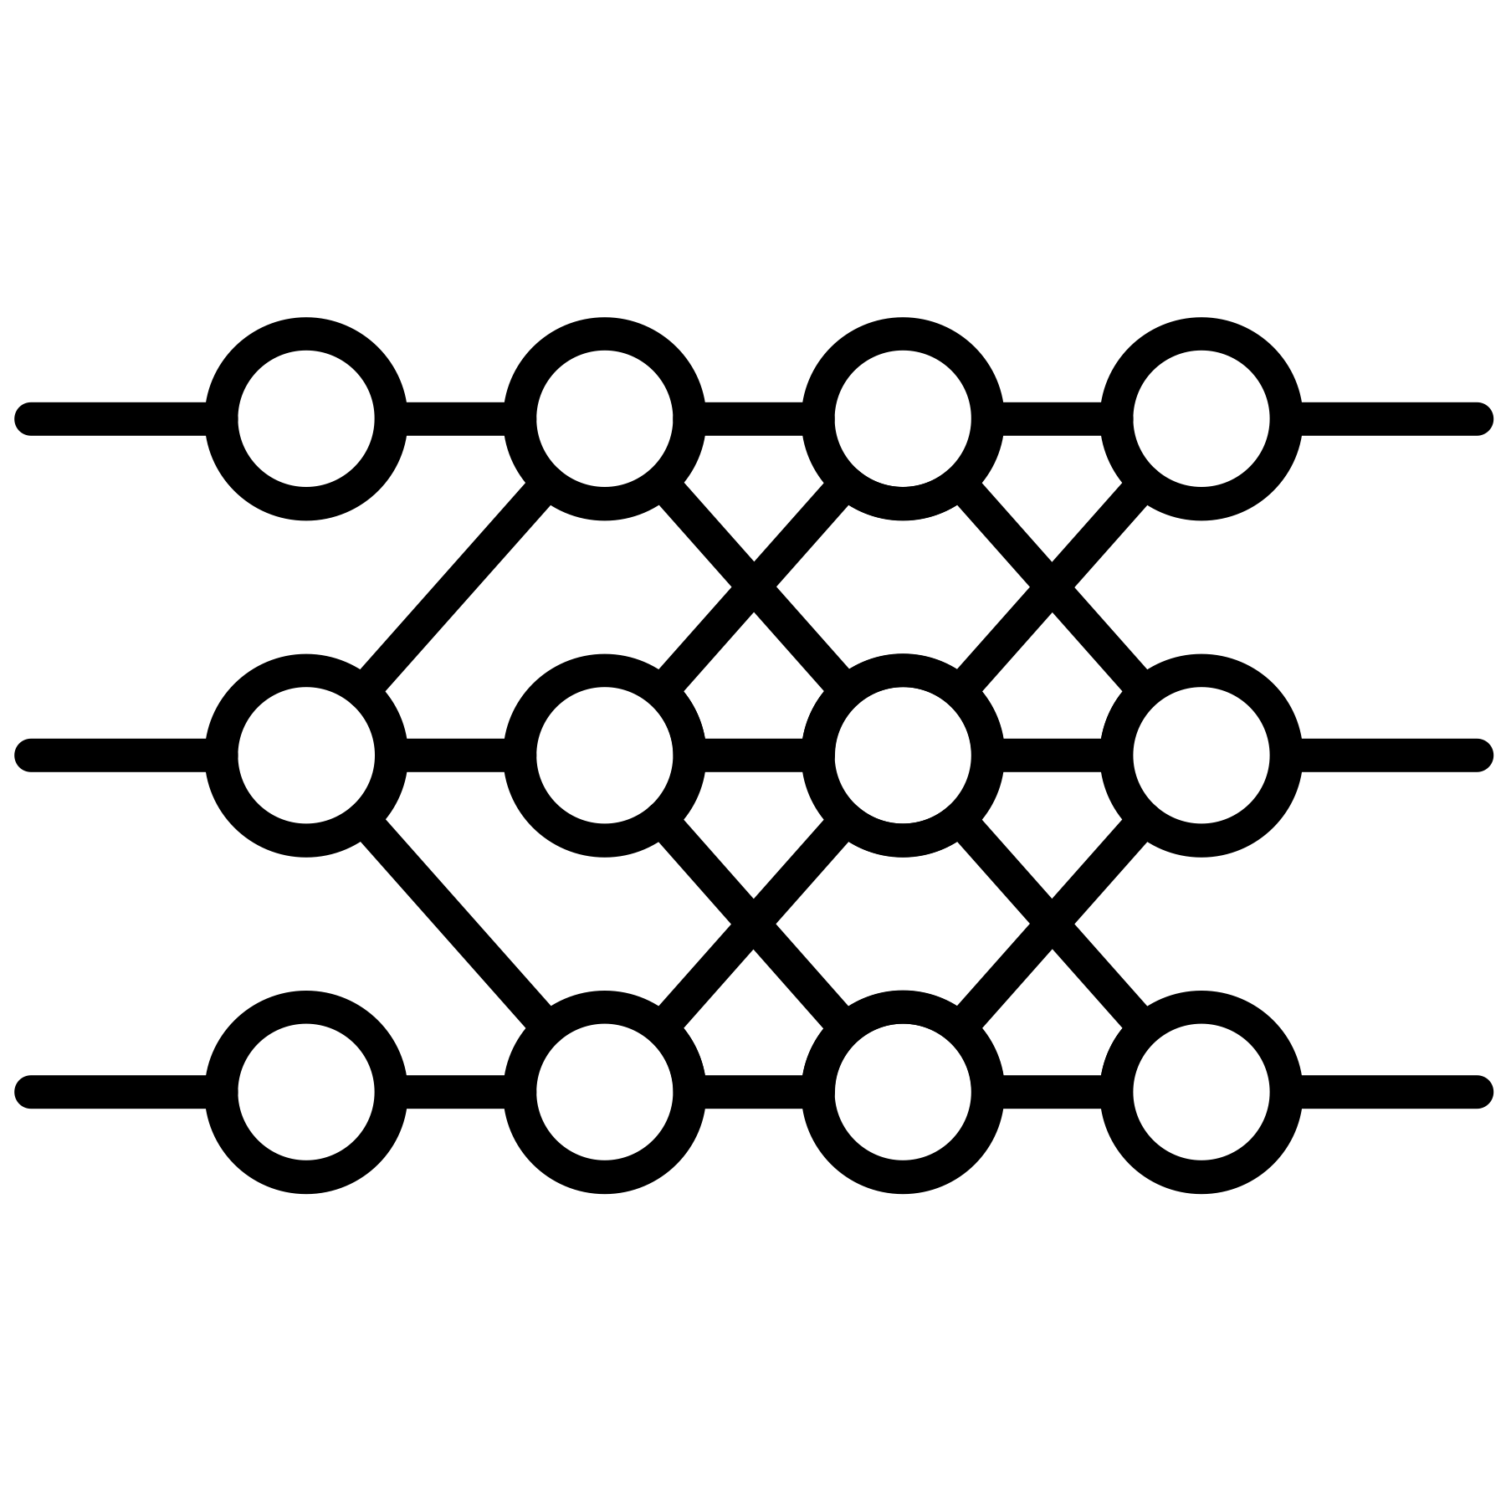



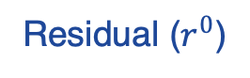
Route, interpret and repeat
Residual ($r^{0}$)
Blackbox Model
Symbolic Model
Selector

Slide 10
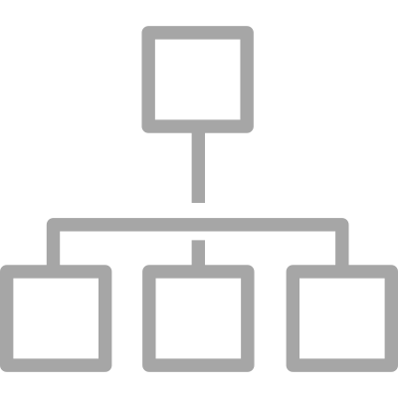
Route, interpret and repeat
Residual ($r^{0}$)
Blackbox Model
Symbolic Model
Selector

Slide 11
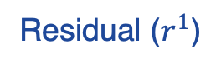
Route, interpret and repeat
Fix
Residual ($r^{0}$)
Residual ($r^{1}$)
Blackbox Model
Symbolic Model
Selector

Slide 12
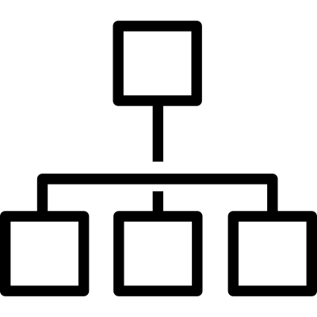
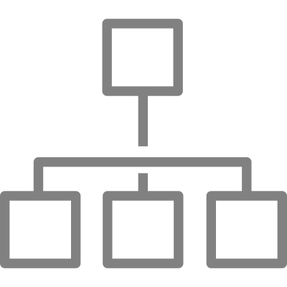
Route, interpret and repeat
Fix
Residual ($r^{0}$)
Residual ($r^{1}$)
Blackbox Model
Symbolic Model
Selector

Slide 13
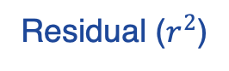
Route, interpret and repeat
Fix
Residual ($r^{0}$)
Residual ($r^{1}$)
Residual ($r^{2}$)
Blackbox Model
Symbolic Model
Selector

Slide 14
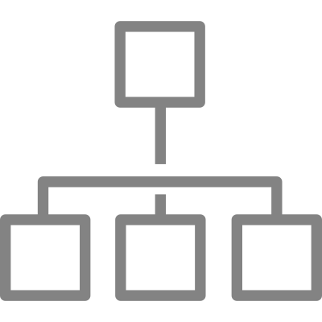
Route, interpret and repeat
Fix
Residual ($r^{0}$)
Residual ($r^{1}$)
Residual ($r^{2}$)
Blackbox Model
Symbolic Model
Selector

Slide 15
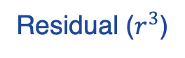
Route, interpret and repeat
Fix
Residual ($r^{0}$)
Residual ($r^{1}$)
Residual ($r^{2}$)
Residual ($r^{3}$)
Blackbox Model
Symbolic Model
Selector

Slide 16
Route, interpret and repeat
Fix
Residual ($r^{0}$)
Residual ($r^{1}$)
Residual ($r^{2}$)
Residual ($r^{3}$)
Blackbox Model
Symbolic Model
Selector
All interpretable models (g) is called Mixture of interpretable experts (MoIE).
Each g is E-LENs (Barberio et al. AAAI 2022) to produce sample specific FOLs.

Slide 17
Experiments
Fine grained classification datasets
CUB-200
AWA2
Medical Imaging datasets
HAM10000
SIIM-ISIC
MIMIC-CXR (Effusion)
https://github.com/batmanlab/ICML-2023-Route-interpret-repeat#downloading-data

Slide 18
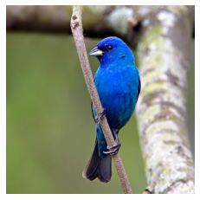
Baselines
CNN / VIT
Logistic
classifier
Indigo Bunting
Indigo Bunting
+
FOL
E-LENs
Replace the standard logistic classifiers in CBM (Koh et el. ICML 2020) and
post-hoc CBM (Yuksekgonul et al. ICLR 2023) with E-LENs to compare the FOLs

Slide 19
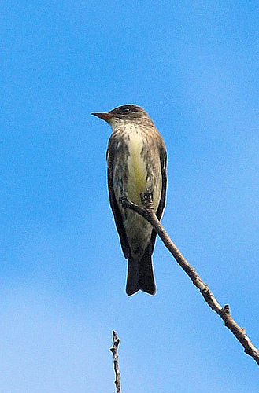
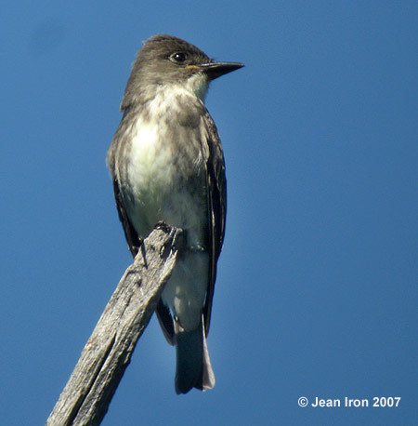
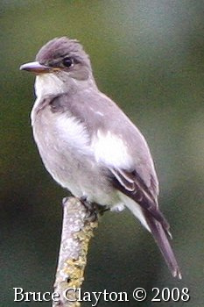
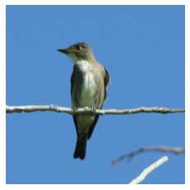
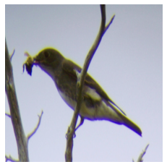
MoIE identifies diverse concepts
MoIE
Colored concepts are unique to the corresponding expert.
Underlined concepts matches the baselines.
Notes:
&\textbf{Olive sided Flycatcher} \leftrightarrow \text{underparts\_color\_grey} \land \\
&\text{wing\_color\_grey} \land \neg\text{belly\_pattern\_solid} \land \\
& \neg\text{breast\_pattern\_solid} \land \neg\text{wing\_shape\_roundedwings}
\textbf{Olive sided Flycatcher} \leftrightarrow & \text{underparts\_color\_grey} \land \\
&\text{wing\_color\_grey}

Slide 20
MoIE identifies diverse concepts
MoIE
Colored concepts are unique to the corresponding expert.
Underlined concepts matches the baselines.
Notes:
&\textbf{Olive sided Flycatcher} \leftrightarrow \text{underparts\_color\_grey} \land \\
&\text{wing\_color\_grey} \land \neg\text{belly\_pattern\_solid} \land \\
& \neg\text{breast\_pattern\_solid} \land \neg\text{wing\_shape\_roundedwings}
\textbf{Olive sided Flycatcher} \leftrightarrow & \text{underparts\_color\_grey} \land \\
&\text{wing\_color\_grey}

Slide 21
MoIE identifies diverse concepts
MoIE
Expert4
Colored concepts are unique to the corresponding expert.
Underlined concepts matches the baselines.
Notes:
&\textbf{Olive sided Flycatcher} \leftrightarrow \text{underparts\_color\_grey} \land \\
&\text{wing\_color\_grey} \land \neg\text{belly\_pattern\_solid} \land \\
& \neg\text{breast\_pattern\_solid} \land \neg\text{wing\_shape\_roundedwings}
\textbf{Olive sided Flycatcher} \leftrightarrow & \text{underparts\_color\_grey} \land \\
&\text{wing\_color\_grey}

Slide 22
MoIE identifies diverse concepts
MoIE
Expert4
Colored concepts are unique to the corresponding expert.
Underlined concepts matches the baselines.
Notes:
&\textbf{Olive sided Flycatcher} \leftrightarrow \text{underparts\_color\_grey} \land \\
&\text{wing\_color\_grey} \land \neg\text{belly\_pattern\_solid} \land \\
& \neg\text{breast\_pattern\_solid} \land \neg\text{wing\_shape\_roundedwings}
\textbf{Olive sided Flycatcher} \leftrightarrow & \text{underparts\_color\_grey} \land \\
&\text{wing\_color\_grey}

Slide 23
MoIE identifies diverse concepts
MoIE
Expert4
Colored concepts are unique to the corresponding expert.
Underlined concepts matches the baselines.
Notes:
&\textbf{Olive sided Flycatcher} \leftrightarrow \text{underparts\_color\_grey} \land \\
&\text{wing\_color\_grey} \land \neg\text{belly\_pattern\_solid} \land \\
& \neg\text{breast\_pattern\_solid} \land \neg\text{wing\_shape\_roundedwings}
\textbf{Olive sided Flycatcher} \leftrightarrow & \text{underparts\_color\_grey} \land \\
&\text{wing\_color\_grey}

Slide 24
MoIE identifies diverse concepts
MoIE
Expert4
Expert6
Colored concepts are unique to the corresponding expert.
Underlined concepts matches the baselines.
Notes:
&\textbf{Olive sided Flycatcher} \leftrightarrow \text{underparts\_color\_grey} \land \\
&\text{wing\_color\_grey} \land \neg\text{belly\_pattern\_solid} \land \\
& \neg\text{breast\_pattern\_solid} \land \neg\text{wing\_shape\_roundedwings}
\textbf{Olive sided Flycatcher} \leftrightarrow & \text{underparts\_color\_grey} \land \\
&\text{wing\_color\_grey}

Slide 25
MoIE identifies diverse concepts
MoIE
Expert4
Expert6
Final Residual (Unexplained)
Colored concepts are unique to the corresponding expert.
Underlined concepts matches the baselines.
Notes:
&\textbf{Olive sided Flycatcher} \leftrightarrow \text{underparts\_color\_grey} \land \\
&\text{wing\_color\_grey} \land \neg\text{belly\_pattern\_solid} \land \\
& \neg\text{breast\_pattern\_solid} \land \neg\text{wing\_shape\_roundedwings}
\textbf{Olive sided Flycatcher} \leftrightarrow & \text{underparts\_color\_grey} \land \\
&\text{wing\_color\_grey}

Slide 26
MoIE identifies diverse concepts
MoIE
Expert4
PCBM + E-LEN
Expert6
Final Residual (Unexplained)
Colored concepts are unique to the corresponding expert.
Underlined concepts matches the baselines.
Notes:
&\textbf{Olive sided Flycatcher} \leftrightarrow \text{underparts\_color\_grey} \land \\
&\text{wing\_color\_grey} \land \neg\text{belly\_pattern\_solid} \land \\
& \neg\text{breast\_pattern\_solid} \land \neg\text{wing\_shape\_roundedwings}
\textbf{Olive sided Flycatcher} \leftrightarrow & \text{underparts\_color\_grey} \land \\
&\text{wing\_color\_grey}

Slide 27
MoIE identifies diverse concepts
MoIE
Expert4
PCBM + E-LEN
Expert6
CBM + E-LEN
Final Residual (Unexplained)
Colored concepts are unique to the corresponding expert.
Underlined concepts matches the baselines.
Notes:
&\textbf{Olive sided Flycatcher} \leftrightarrow \text{underparts\_color\_grey} \land \\
&\text{wing\_color\_grey} \land \neg\text{belly\_pattern\_solid} \land \\
& \neg\text{breast\_pattern\_solid} \land \neg\text{wing\_shape\_roundedwings}
\textbf{Olive sided Flycatcher} \leftrightarrow & \text{underparts\_color\_grey} \land \\
&\text{wing\_color\_grey}

Slide 28
MoIE does not compromise performance

Slide 29
MoIE does not compromise performance

Slide 30
MoIE does not compromise performance

Slide 31
MoIE does not compromise performance

Slide 32
MoIE does not compromise performance

Slide 33
MoIE does not compromise performance

Slide 34
MoIE does not compromise performance

Slide 35
MoIE does not compromise performance
* Concepts for skin datasets are extracted from pretrained model, so CBM and other interpretable by design models are not possible for HAM10000 and SIIM-ISIC

Slide 36
MoIE does not compromise performance
* Concepts for skin datasets are extracted from pretrained model, so CBM and other interpretable by design models are not possible for HAM10000 and SIIM-ISIC

Slide 37
MoIE does not compromise performance
* Concepts for skin datasets are extracted from pretrained model, so CBM and other interpretable by design models are not possible for HAM10000 and SIIM-ISIC

Slide 38
MoIE does not compromise performance

Slide 39
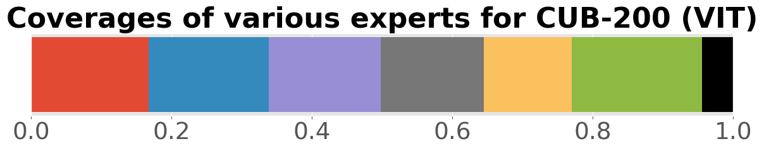
Residuals gradually perform poorly

Slide 40
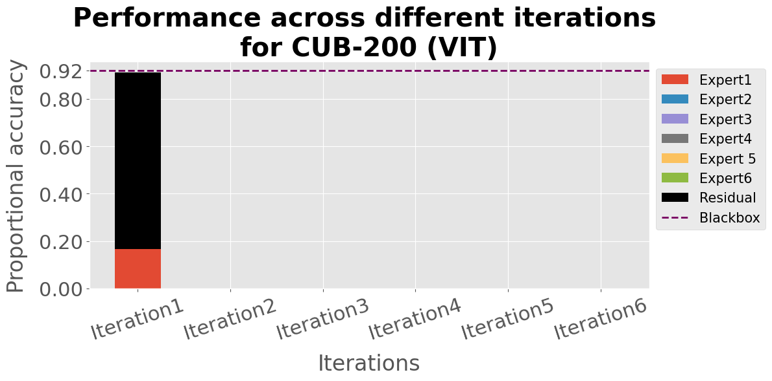
Residuals gradually perform poorly

Slide 41
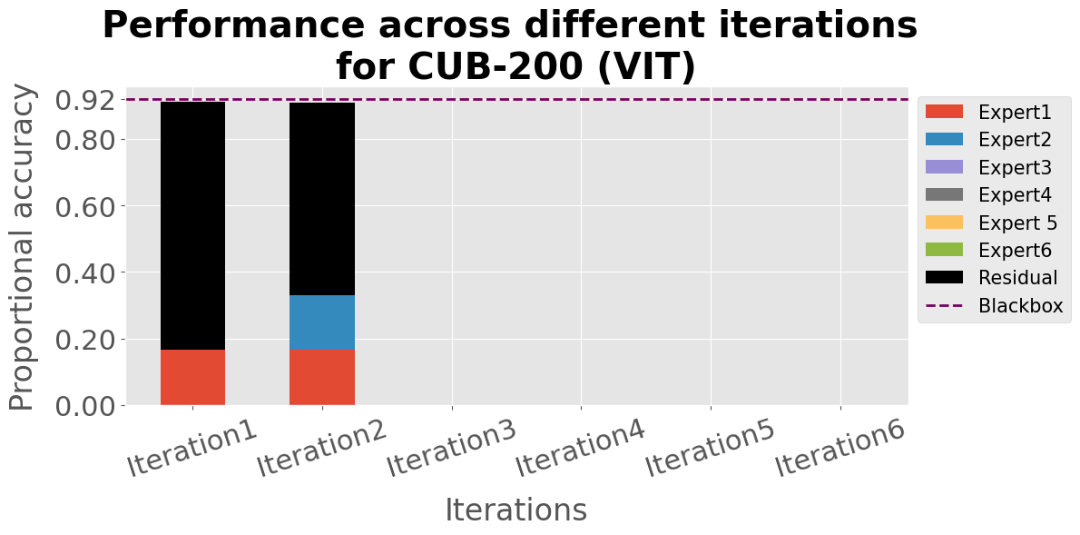
Residuals gradually perform poorly

Slide 42
Residuals gradually perform poorly

Slide 43
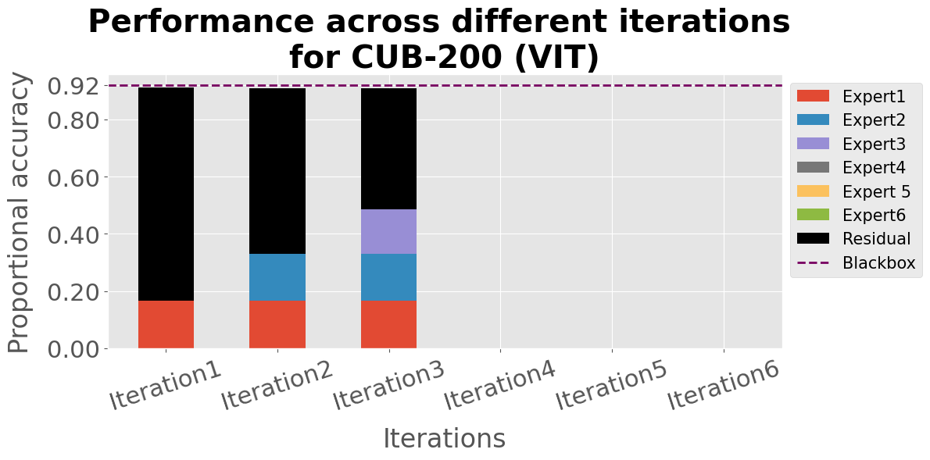
Residuals gradually perform poorly

Slide 44
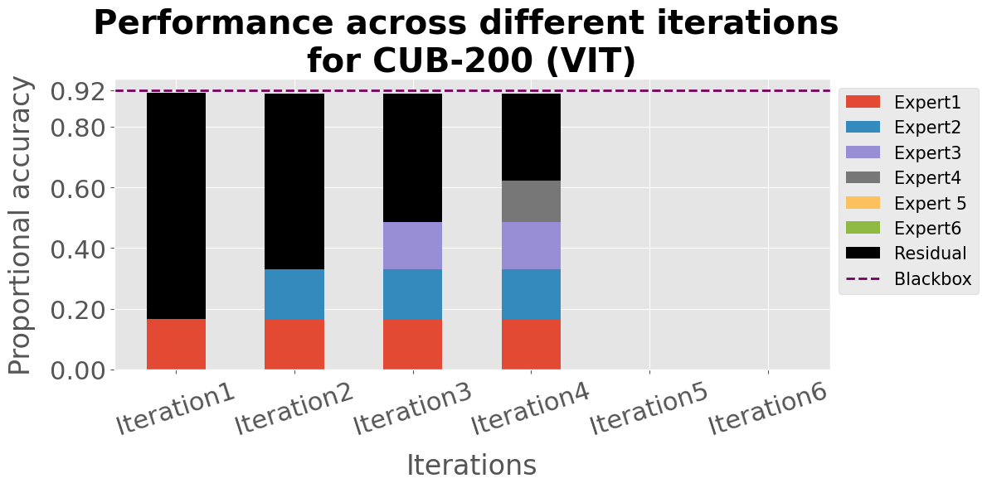
Residuals gradually perform poorly

Slide 45
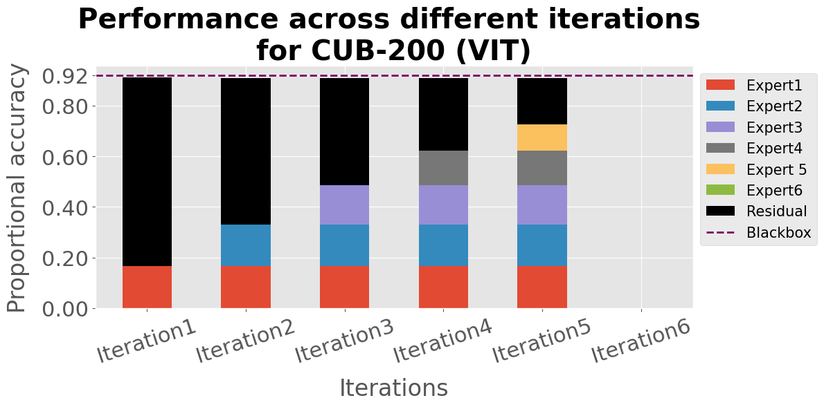
Residuals gradually perform poorly

Slide 46
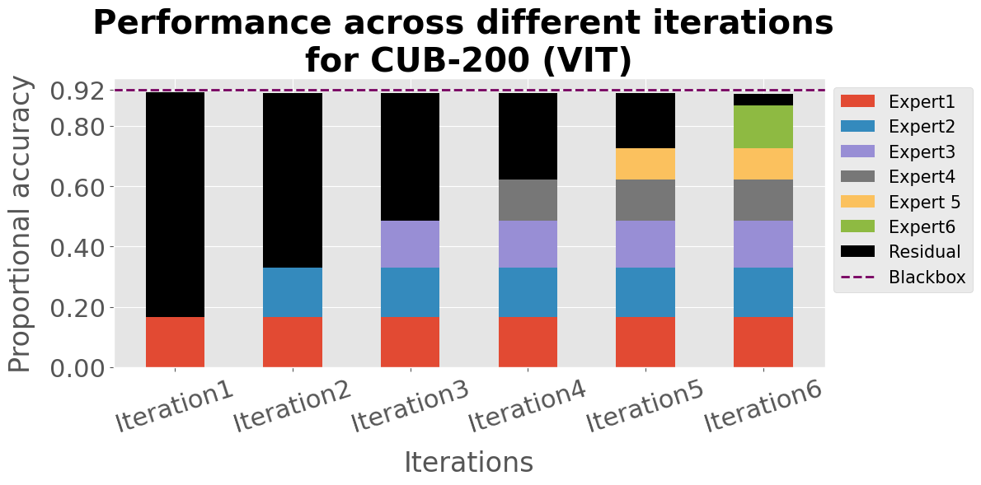
Residuals gradually perform poorly

Slide 47
Residuals gradually perform poorly

Slide 48
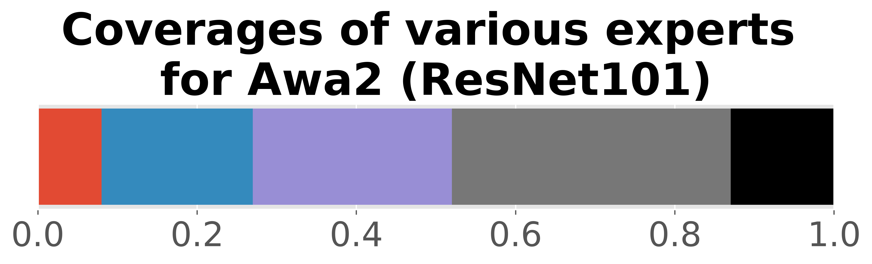
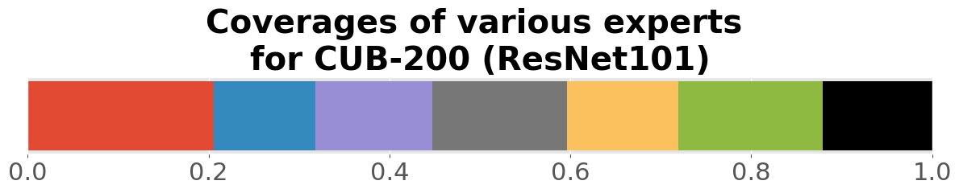
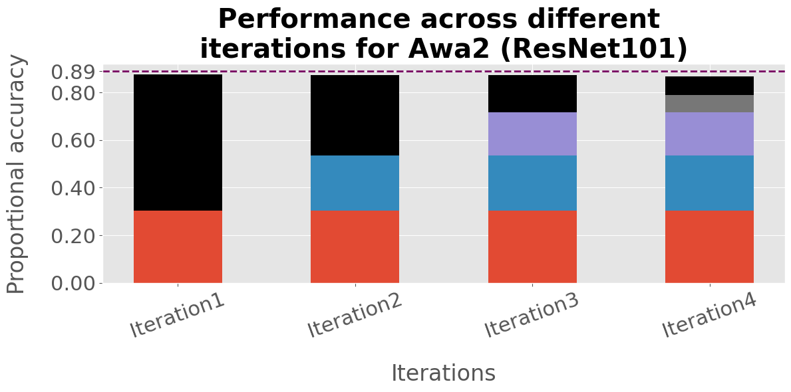
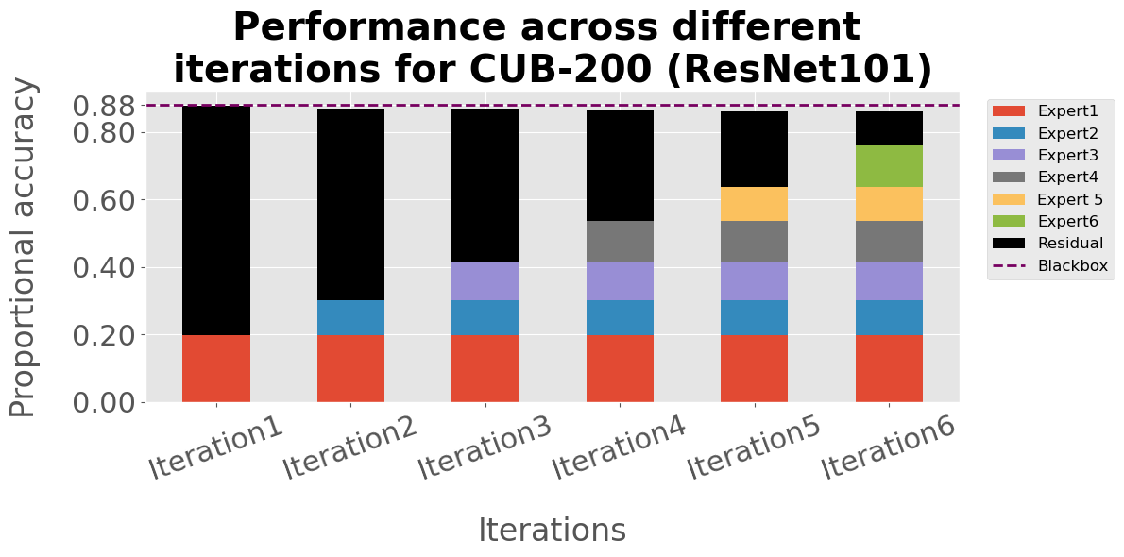
Residuals gradually perform poorly
Same story for other datasets and architectures

Slide 49
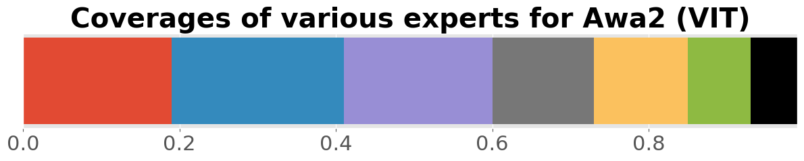
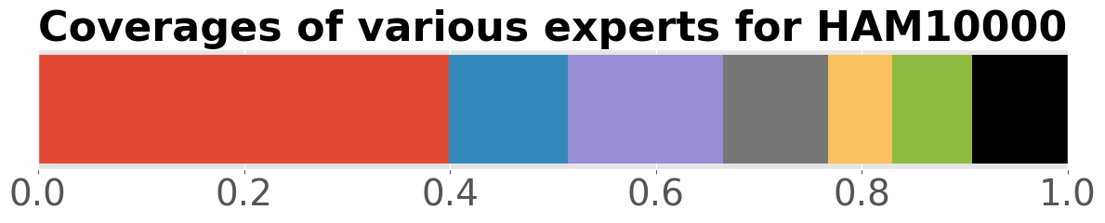
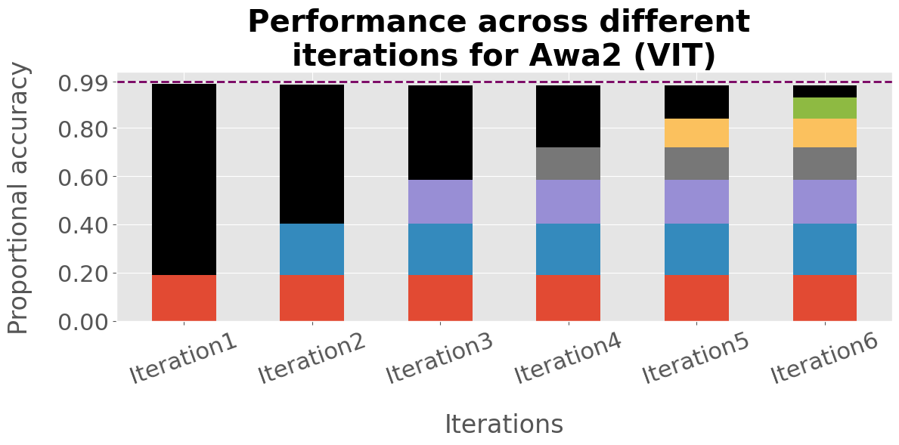
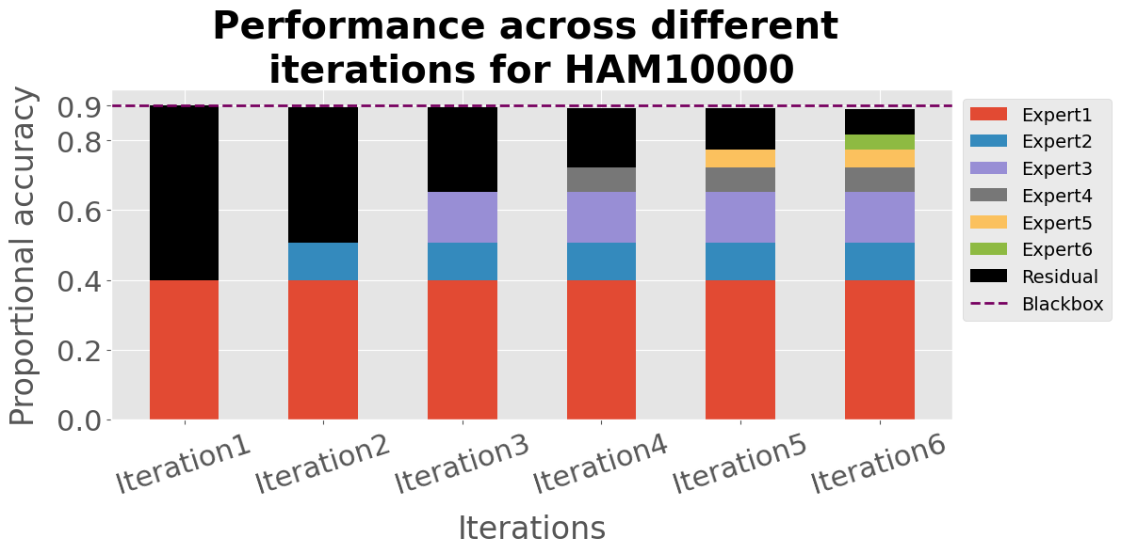
Residuals gradually perform poorly
Same story for other datasets and architectures

Slide 50
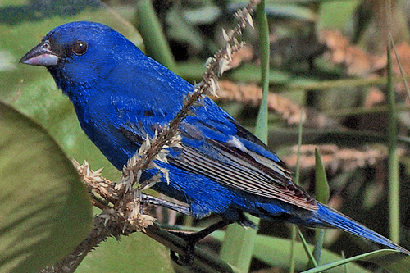
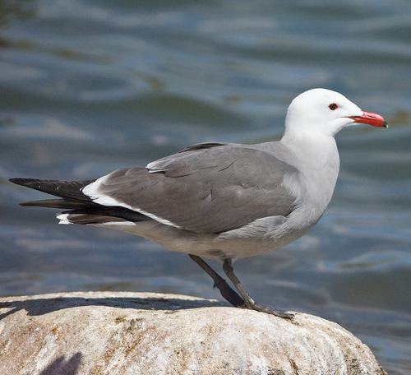
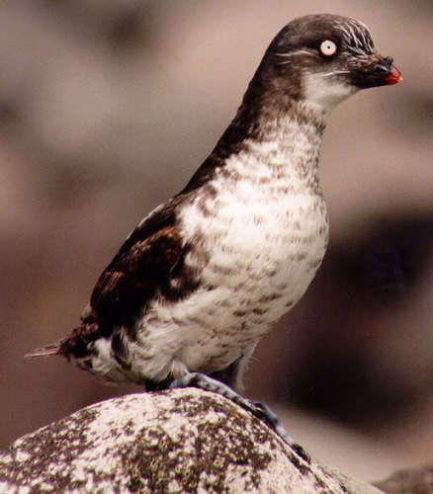
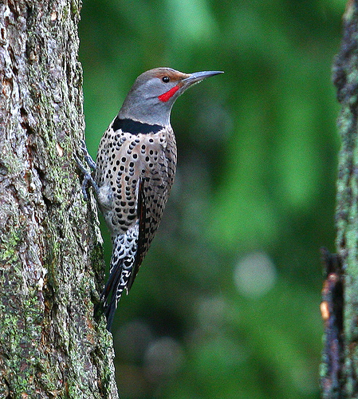
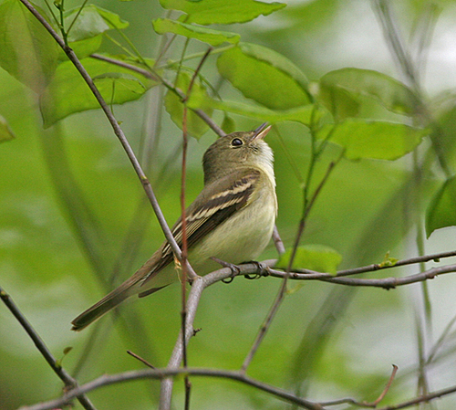
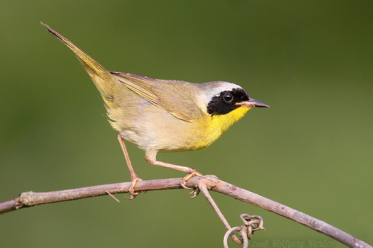
Later residuals cover harder samples

Slide 51
Later residuals cover harder samples

Slide 52
Later residuals cover harder samples
Performance

Slide 53
Later residuals cover harder samples
Performance

Slide 54
Later residuals cover harder samples
Performance
Performance

Slide 55
Later residuals cover harder samples
Performance
Compare
Performance

Slide 56
Later residuals cover harder samples
Performance
Compare
Performance
Performance
Compare
…
Performance

Slide 57
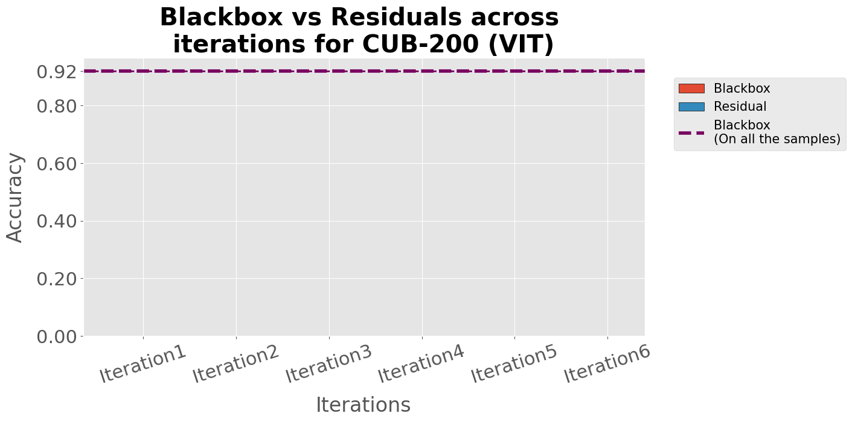
Later residuals cover harder samples

Slide 58
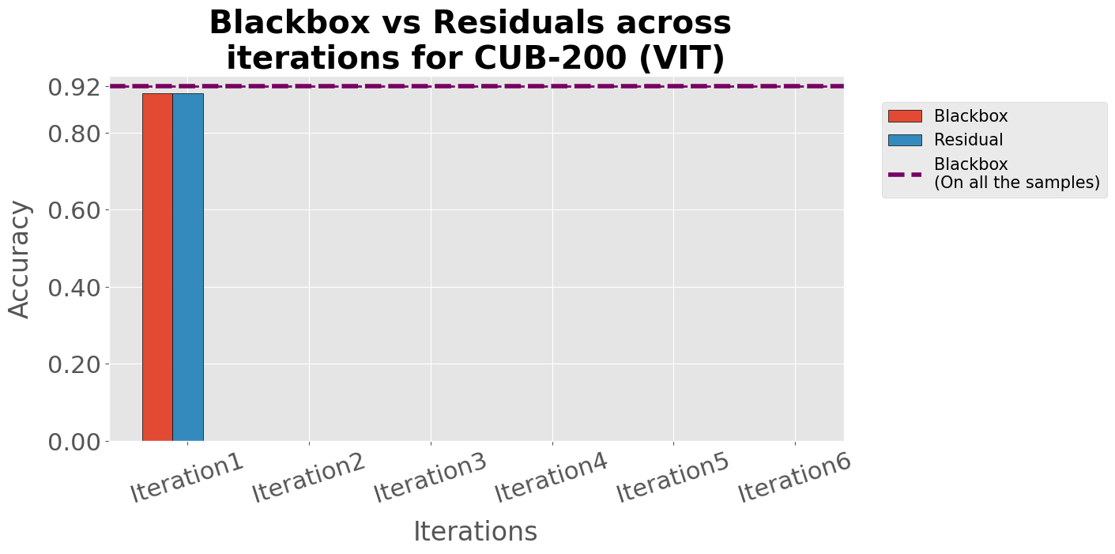
Later residuals cover harder samples

Slide 59
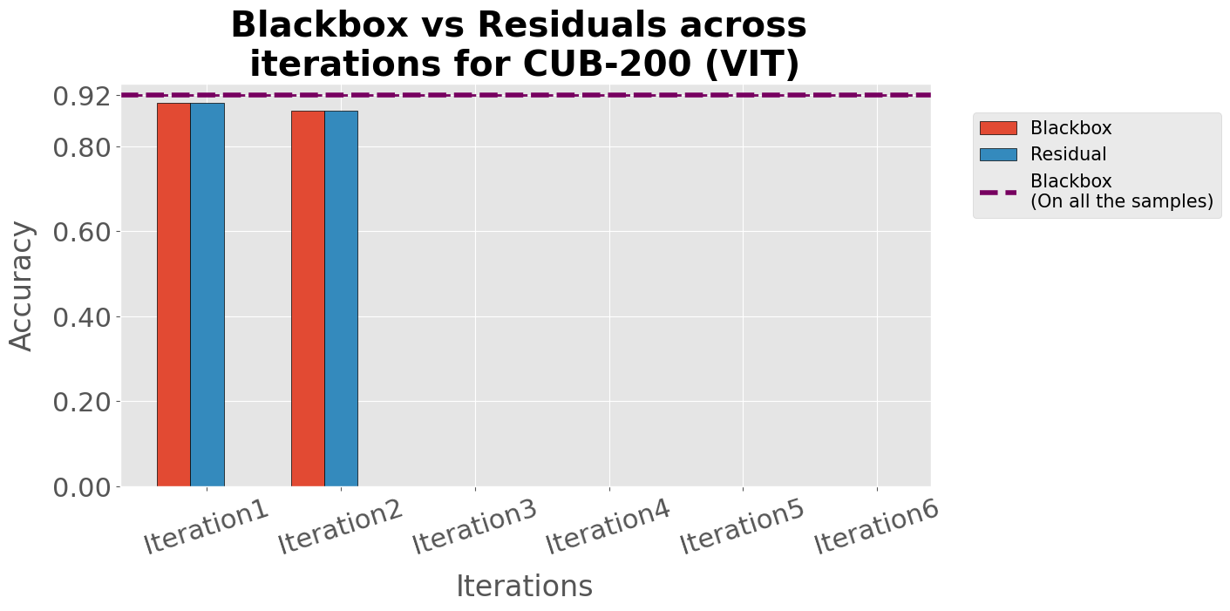
Later residuals cover harder samples

Slide 60

Later residuals cover harder samples

Slide 61

Later residuals cover harder samples

Slide 62

Later residuals cover harder samples

Slide 63

Later residuals cover harder samples

Slide 64




Later residuals cover harder samples
Same story for other datasets and architectures

Slide 65

Test time interventions on hard samples
Chose the misclassified samples covered by the last 2 experts
Expert6
Attention weights
Concepts
Concept values
Oracle
0.0120
bill_length_shorter_than_head
0.192
0
Descending
order
0.0118
bill_shape_allpurpose
0.949
Intervene
1
0.0118
wing_shape_roundedwings
0.403
1
…
…
…
…
Prediction (y):
Brewer Blackbird
Fish Crow
Wrong
Right

Slide 66

Test time interventions on hard samples
Intervening on top 75 concepts
CUB-200 (ResNet101) – 5.49 % ↑
CUB-200 (VIT) – 6.5 % ↑
AWA2 (ResNet101) – 5.74 % ↑
AWA2 (VIT) – 2.42 % ↑

Slide 67






Test time interventions

Slide 68

We have more results
MoIE eliminates shortcut (Also in SCIS workshop)
MoIE achieves higher completeness scores
We update to MoIE-CXR to perform efficient transfer learning for CXRs (Also in IMLH workshop and MICCAI 2023)
Scan for project
See you in the poster session

Slide 69
Scan for project
Thank you
Shantanu Ghosh, Ke Yu, Forough Arabshahi, Kayhan Batmanghelich

